Slide 1
Lecture 7: More on Use Quaternions as Rotations in R³ and Finding a Tangent Plane of SO(3)
Math 142
Prof. Gu

Slide 2
Recall: We try to use a unit quaternion to define a rotation in R³
We first defined a map:
R_{q}(p) = qpq⁻¹
2. We need to show R_{q} is an orthogonal map:
R_{q}keeps the length.
R_{q} is linear
How to make R_{q} from R³ to R³?
How to show R_{q} is in SO(3) not just in O(3)? (Is R_{q} continuous?)
Q: What else we must shown? Why can’t we define a rotation as R_{q}(p) = qp?
Note: For unit quaternion q,
Inverse (q) = conjugate (q).
Why?

Slide 3
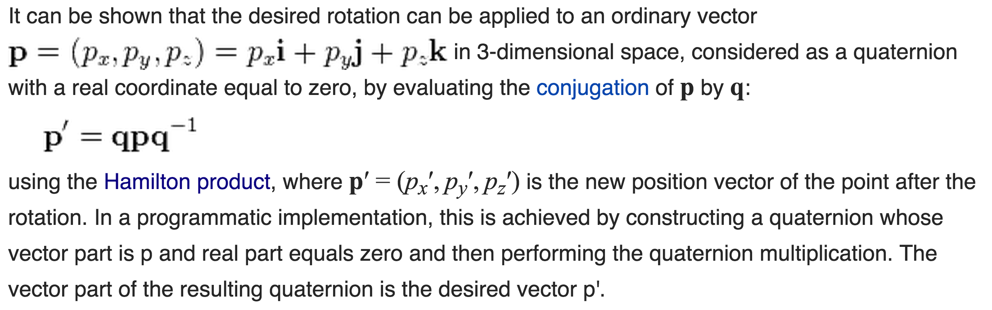
In other words…

Slide 4
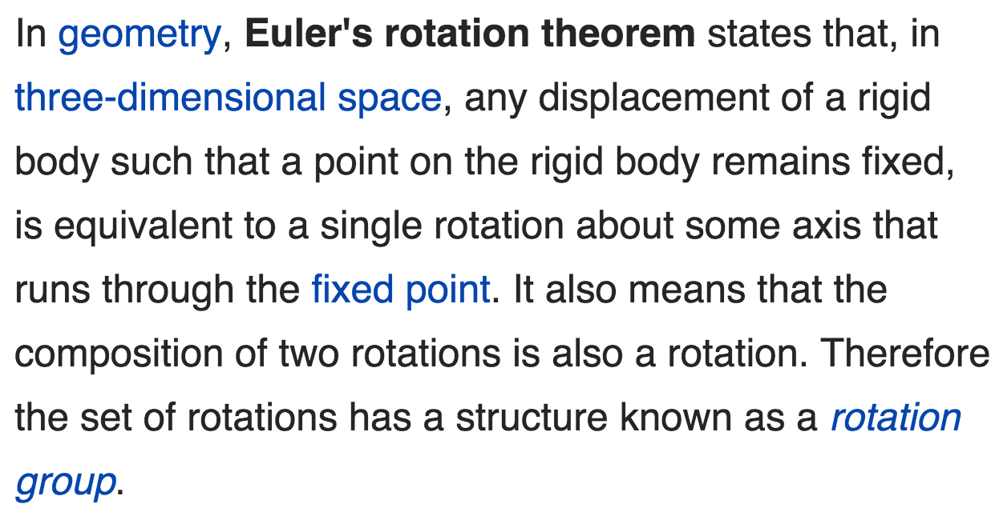
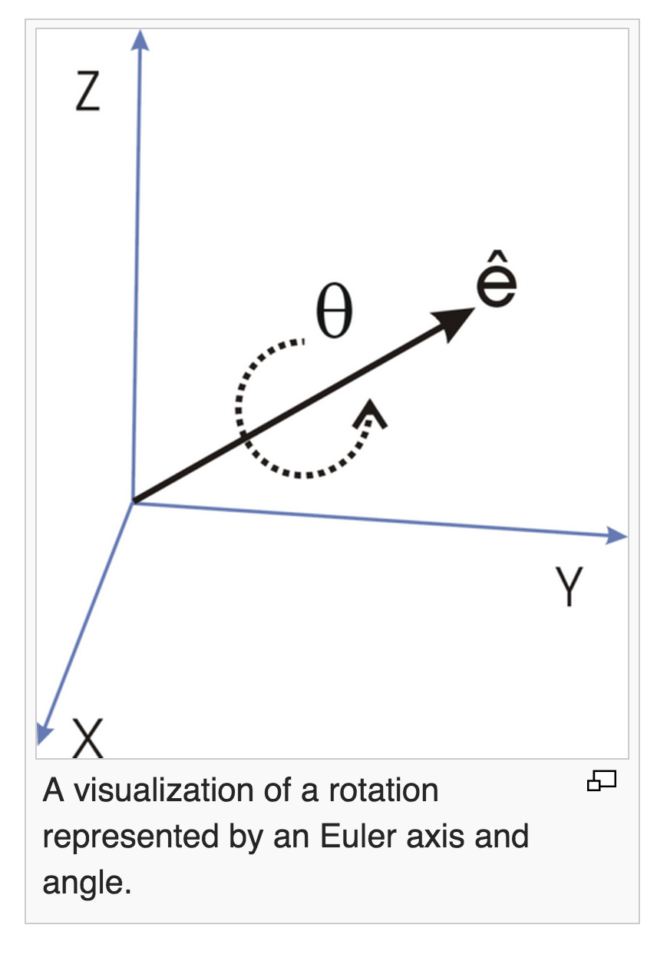
Euler’s Rotation Theorem

Slide 5
How to find Euler axis?
What is the dimension of this rotation matrix?
Does it has a real eigenvalue?
Is there any eigenvector?

Slide 6
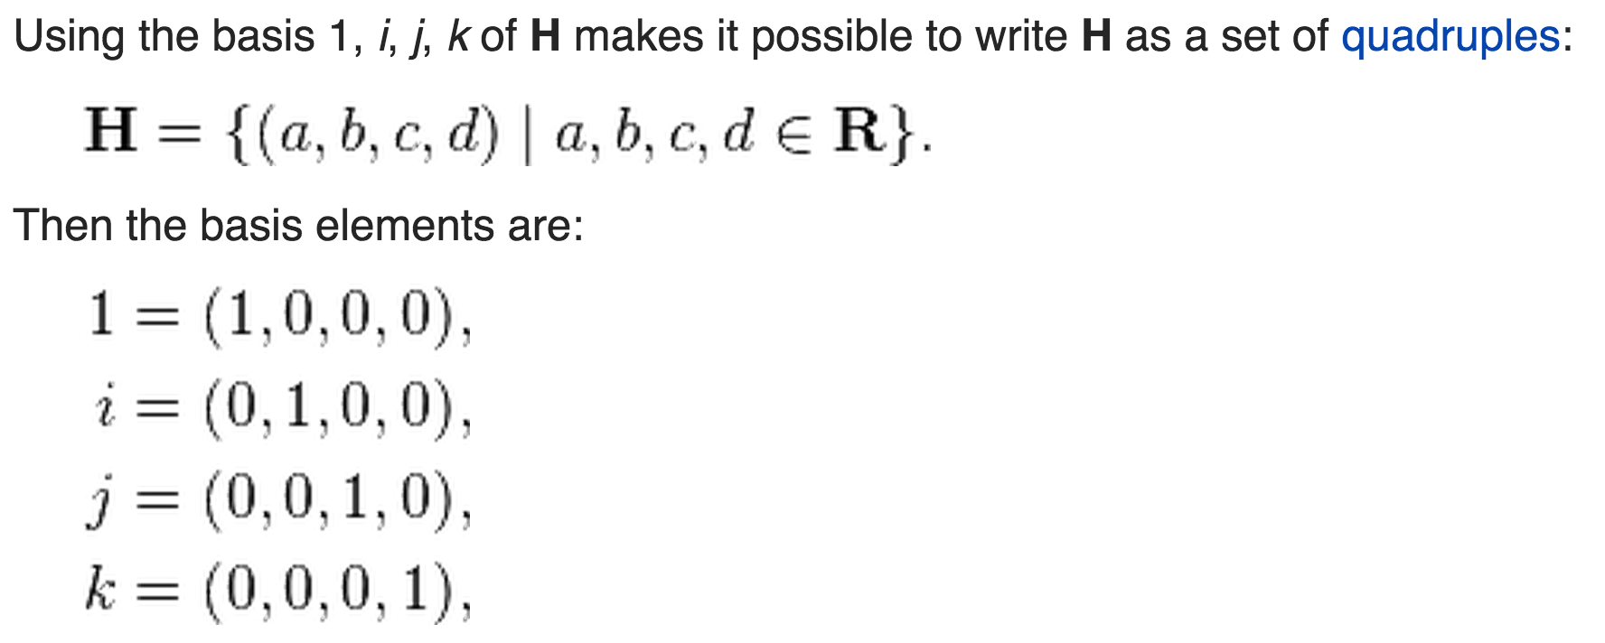
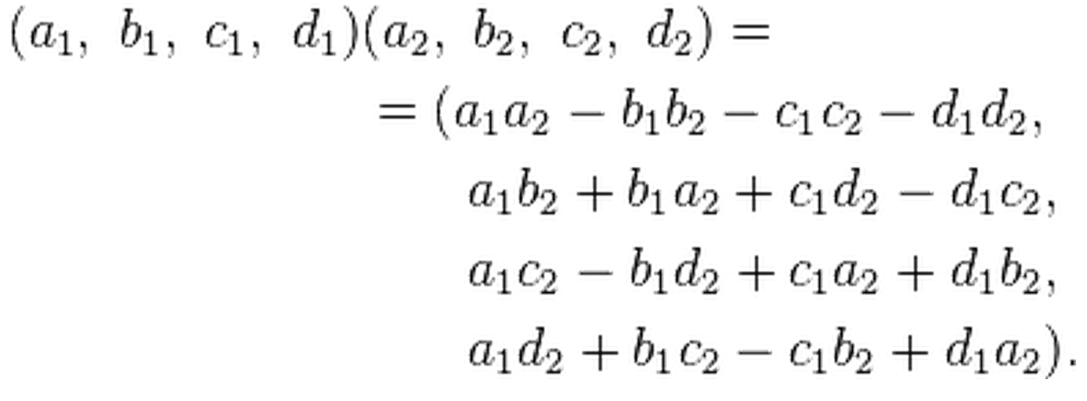
In this topic, we always need to identify H with R⁴ But more, now vectors in R⁴ can multiply and get another vector!

Slide 7
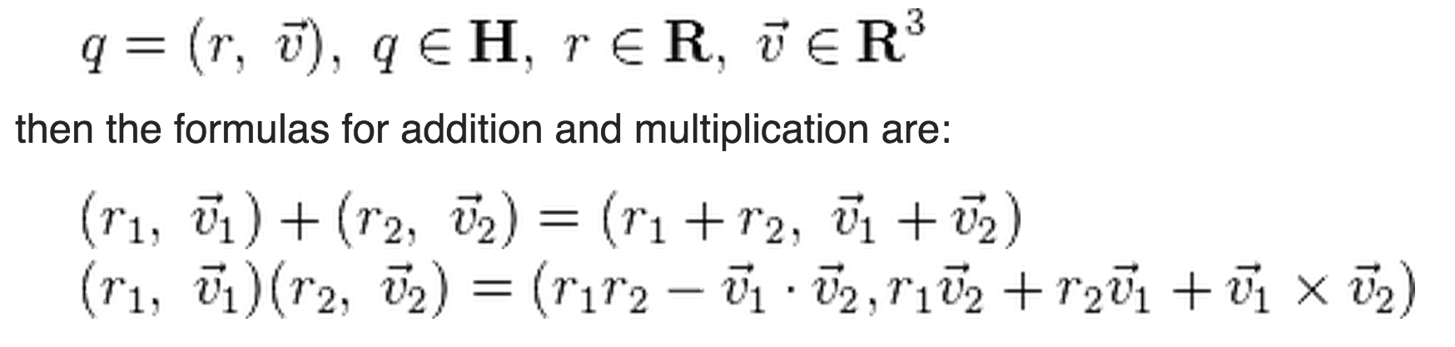
Quaternion multiplication in R⁴ is related to dot product and cross product in R³
Scalar and vector parts:
A number of the form a + 0i + 0j + 0k, where a is a real number, is called real, and a number of the form 0 + bi + cj + dk, where b, c, and d are real numbers, and at least one of b, c or d is nonzero, is called pure imaginary. If a + bi + cj + dk is any quaternion, then a is called its scalar part and bi + cj + dk is called its vector part.

Slide 8
Exactly How quaternion multiplications related to dot and cross product in R³?

Slide 9
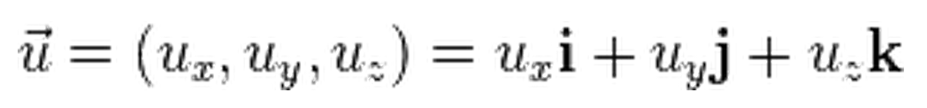
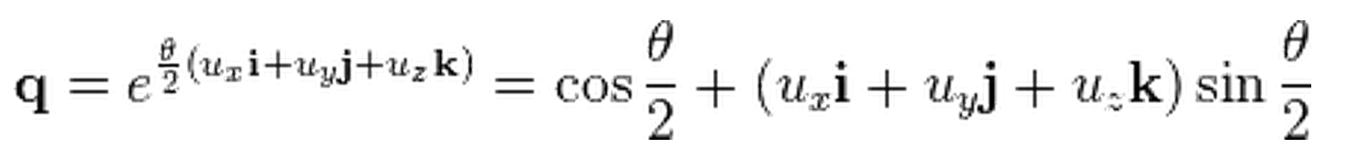
Extend 2D rotation using a unit complex number to 3D rotation using a unit quaternion How?
A rotation through an angle of θ around the axis defined by a unit vector in R³
can be represented by a unit quaternion. This can be done using an extension of Euler's formula:

Slide 10
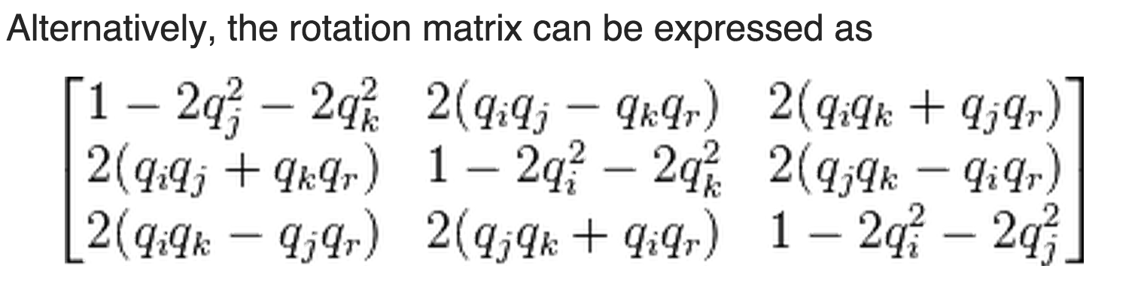
Matrix Representation of Rotation using Unit Quaternion q
How to find this matrix representation?
Key: Look at where the base vectors 1, i, j, and k
go under the R_{q}

Slide 11
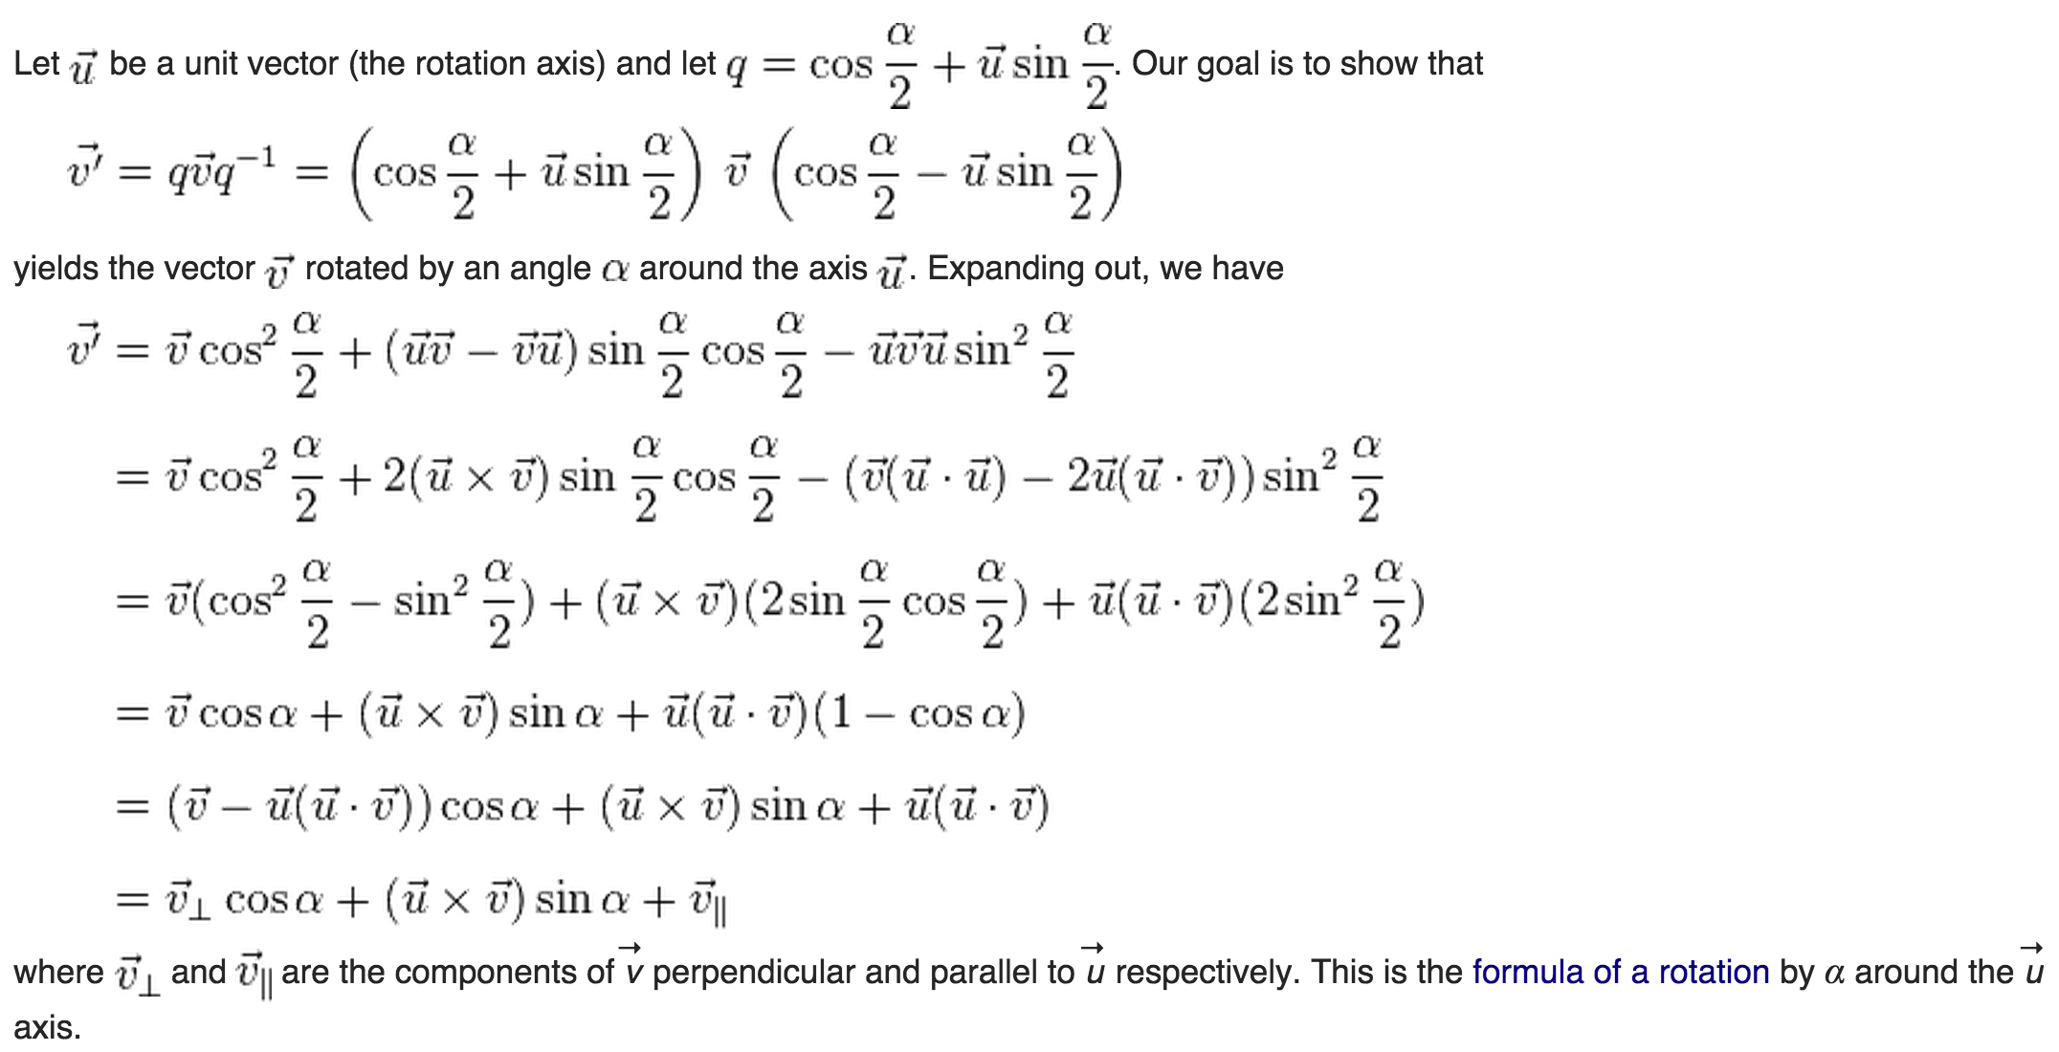
Proof of the quaternion rotation identity

Slide 12
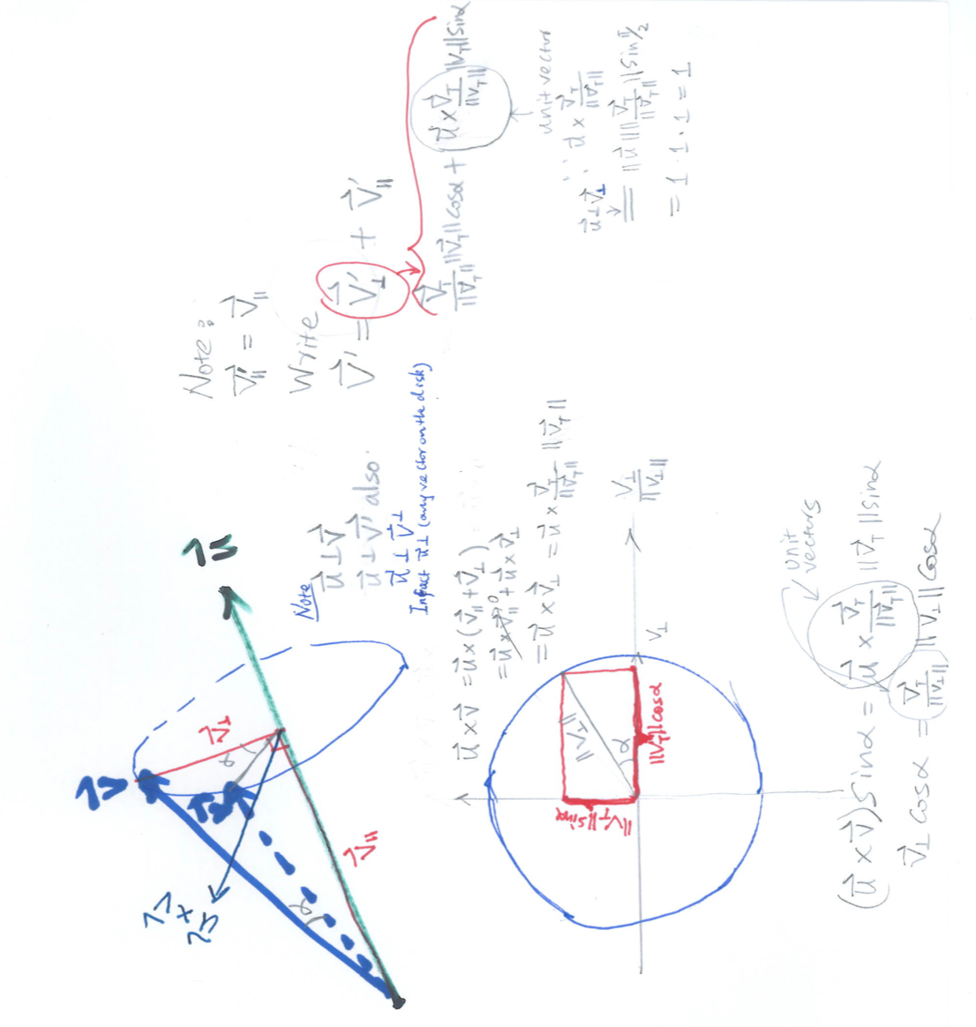
Work out details on the board.

Slide 13
Local Canonical Form of Curves
Using moving frame and view the curve in that frame locally.
Using Taylor expansion (Note: The Reminder R is a vector and limR/s³=0 as s→0.
Plug Frenet formulas in.
Reconcile
Get Local Canonical Form of Curves.
See page 27, Do Carmo.

Slide 14
Think: Can we multiply two vectors in R^{n} for any n?
Yes, in R¹
Yes, in R² (using complex numbers)
Yes, in R³ (using cross product)
Yes, in R⁴ (using Quaternion numbers)
Yes in R⁸ (using Octonion (i.e. Cayley) numbers)
Hint: please look at normed division algebra online.

